Slide 1
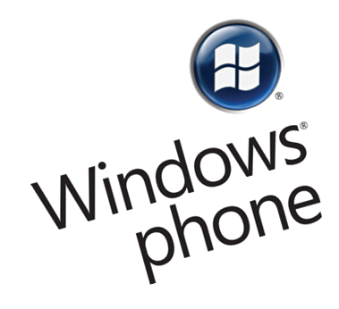
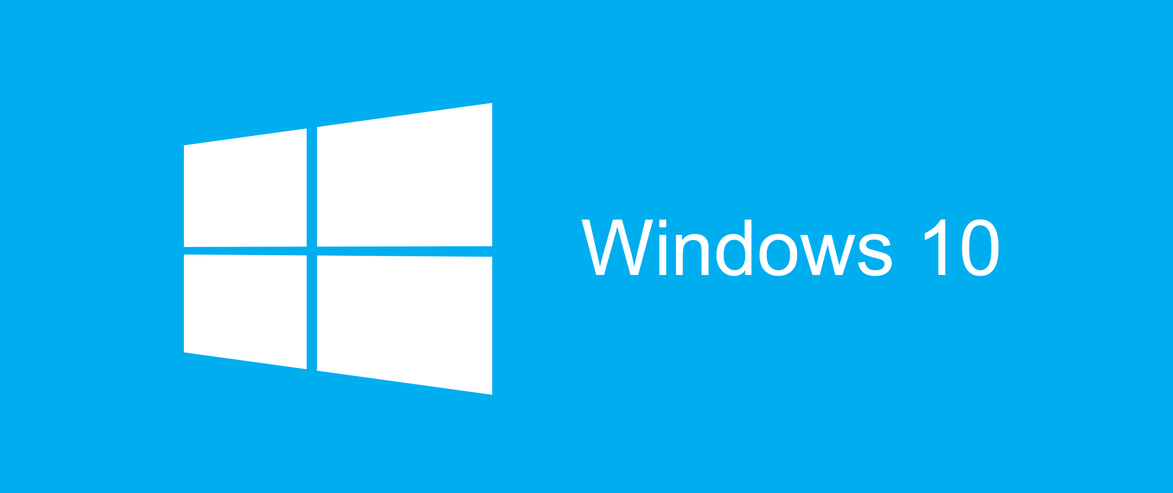

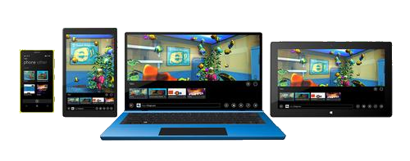
Windows-based Applications History

Slide 2

Table of Contents
History of Windows OS for Desktop
From Windows 3.0 to Windows 10
History of Windows OS for Mobile
From Windows CE to Windows Mobile to Windows Phone to Windows 10 Mobile
Ways to Develop Windows Applications
MFC, WinForms, WPF
Windows Universal Apps (Win 8.1)
Universal Windows Platform (Win10)
Other Platforms for Windows Apps
Unity3D, Xamarin, Apache Cordova

Slide 3
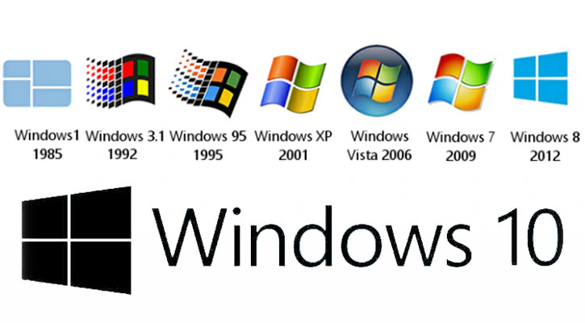
History of Windows OS

Slide 4
Windows OS History
Domestic Use
MS-DOS
Windows 1
Server
Corporate Use
Windows 2
Windows 3
NT Server 3
Windows 3.1 and 3.11
Windows NT 3
NT Server 4
Windows NT 4
Windows 95
Windows 98
Windows ME
Server 2000
Windows 2000
Server 2003 (+R2)
Windows XP
Windows XP Home
Server 2008
Windows Vista
Windows Vista Home
Server 2008 R2
Windows 7
Windows 7 Home
Server 2012
Windows 8
Windows 8 Home

Slide 5

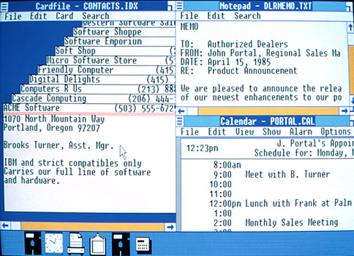
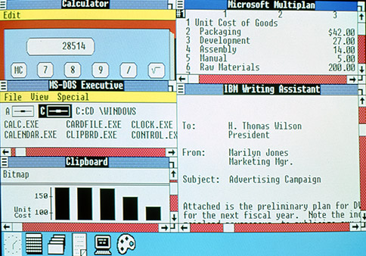
First Windows Versions
1975–1981: Microsoft boots up
MS‑DOS
1982–1985: Introducing Windows 1.0
1987–1990: Windows 2.0–2.11 – More windows

Slide 6
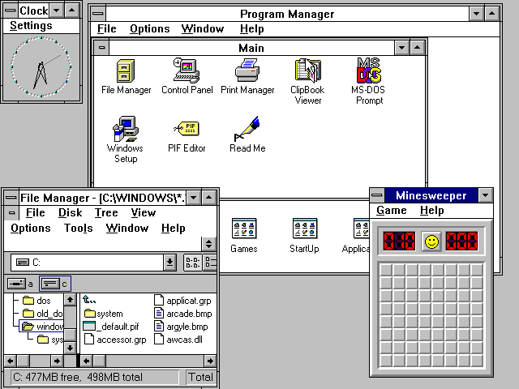
Windows 3.0
Windows 3.0
Release: May 1990
Support end: Dec 2001
Able to compete with
Macintosh UI
Multimedia upgrade kit
CD-ROM
Sound card

Slide 7
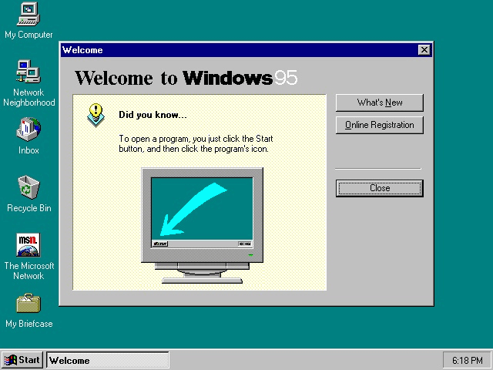
Windows 95
Windows 95
Release: Aug 1995
Support end: Dec 2001
Consumer oriented
Key new features:
Win32 API
The “Start” button
The taskbar

Slide 8
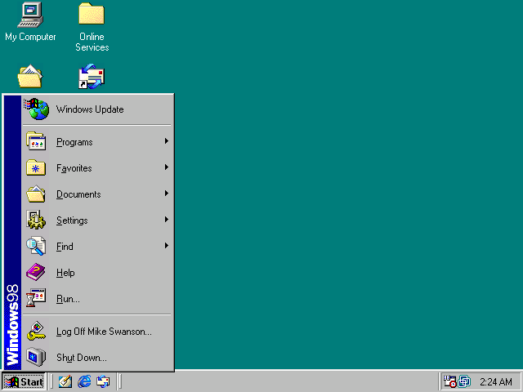
Windows 98
Windows 98
Release: June 1998
Support end: July 2006
Key new features
Windows Driver Model
Wider support for USB
ACPI support – Standby and Hibernate states

Slide 9
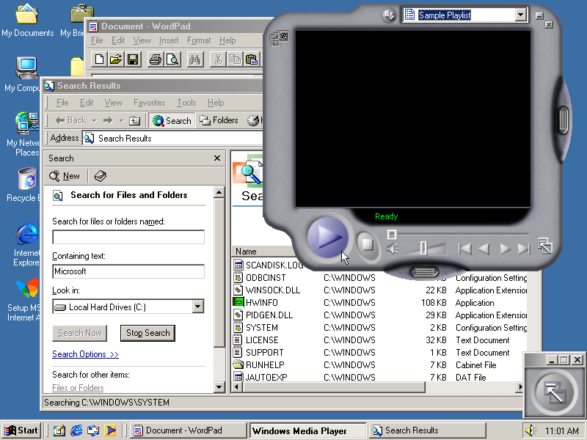
Windows Millennium Edition
Windows ME (Mistake Edition)
Release: Sep 2000
Support end: Jul 2006
Main target home PC users
Key new features
Customizable Windows Explorer toolbars
Personalized menus
Autocomplete in Windows Explorer address bar

Slide 10
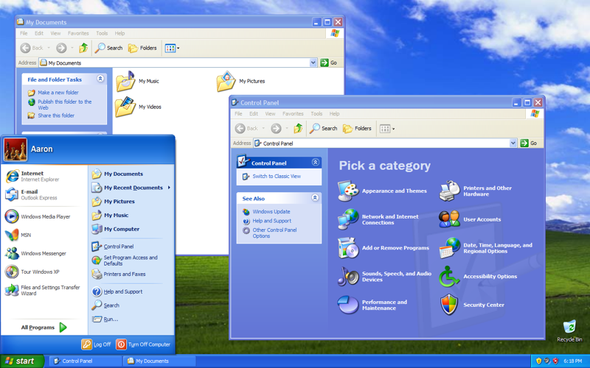
Windows XP
Windows XP
Release: Dec 2001
Support end: April 2014
Improved hardware support
Key new features
Windows Product Activation
Internet Connection Firewall
Internet Connection Sharing
Remote Desktop

Slide 11
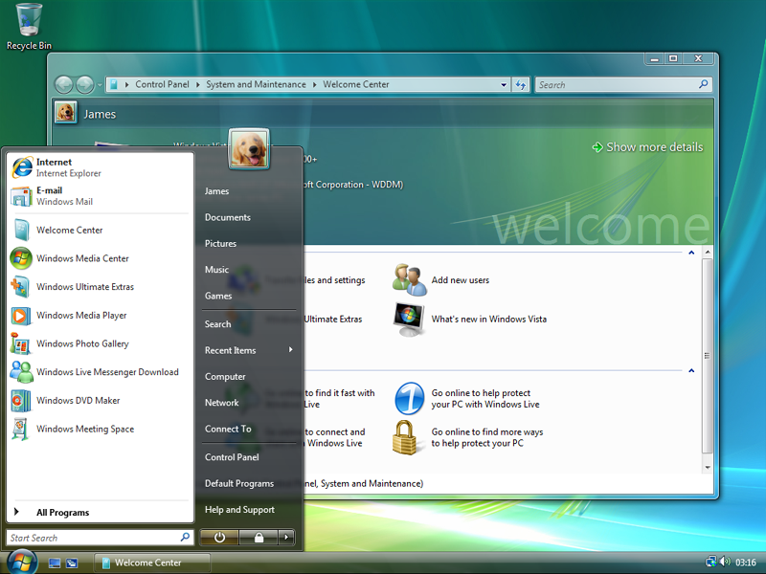
Windows Vista
Windows Vista
Release: Jan 2007
Support end: April 2017
Improved security
Kew new features
Improved UI – Windows Aero
Windows Search
Increased level of communication between home network machines

Slide 12
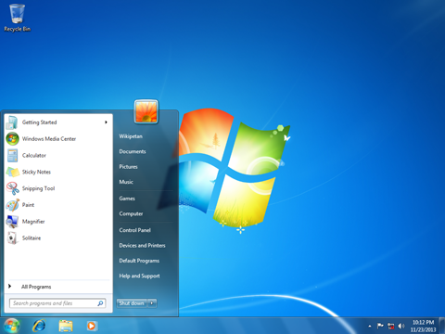
Windows 7
Windows 7
Released: Oct 2009
Support end: Jan 2020
Key new features
Improved performance on multi-core CPUs
Taskbar “pin application”

Slide 13
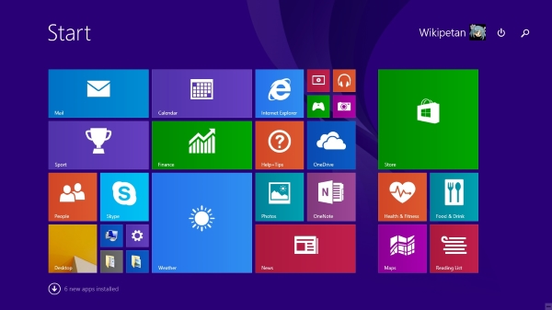
Windows 8
Windows 8
Released: Oct 2012
Support end: Jan 2023
Metro Design
Key new features
Windows Store
Improved mobile UI
New start screen
USB 3.0 support

Slide 14
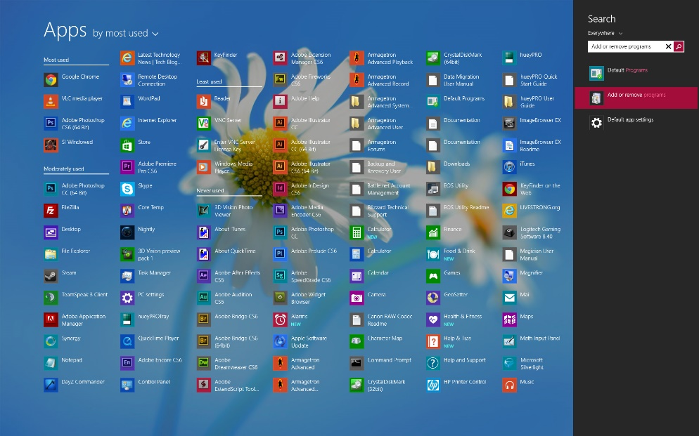
Windows 8.1
Windows 8.1
Released: Oct 2013
Support end: Jan 2023
Major update to Win 8
Key new features
All Apps view
Improved window snapping
Tighter OneDrive integration
Support for 3D printing using NFC tags

Slide 15
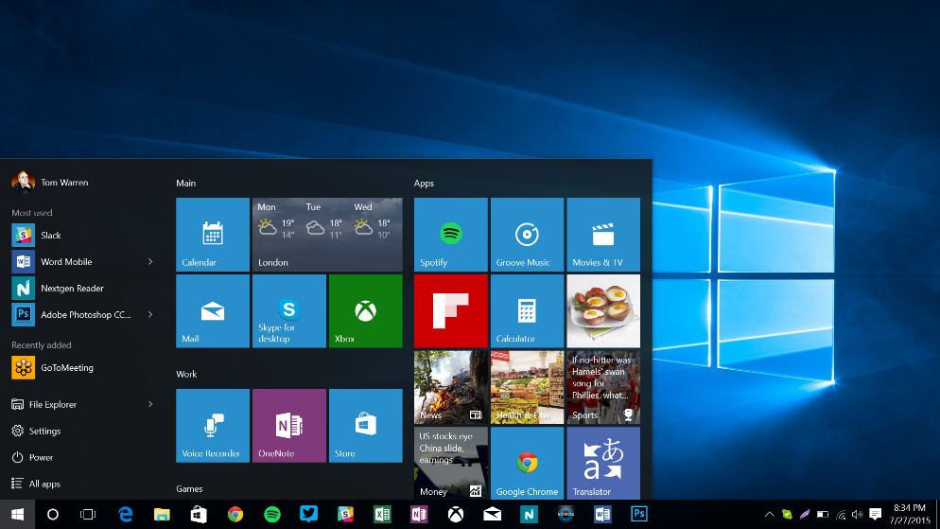
Windows 10
Windows 10
Released: Jul 2015
Support end: Oct 2025
Free for Win 8 users
Key new features
Harmonized UX between all devices
Universal Windows Platform
Shared code and UI for desktop and mobile
Responsive design

Slide 16
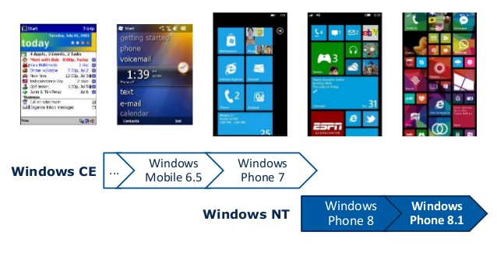
History of Windows OS for Mobile

Slide 17
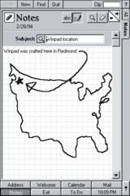
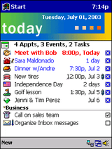
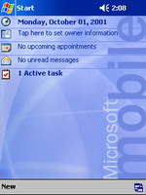
Windows Mobile History
Windows CE
Based on Windows 95 code
UI developed separately (WinPad)
Pocket PC 2000
Released on April 19, 2000
Based on Windows CE 3.0
Pocket PC 2002
Released in October 2001
Meant to be similar to Windows XP

Slide 18
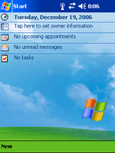
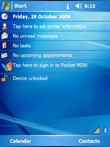
Windows Mobile History (2)
Windows Mobile 2003
Released on June 23, 2003
First release named Windows Mobile
Superseded by Windows Mobile 2003 SE on March 24, 2004
Windows Mobile 5
Released on May 2005
.NET Compact Framework 1.0 SP3
A lot of enchacements

Slide 19
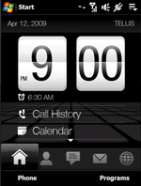
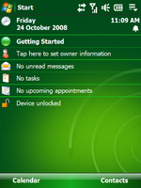
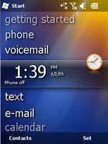
Windows Mobile History (3)
Windows Mobile 6
Released on February 12, 2007
Similar in design to Windows Vista
Windows Mobile 6.1
Announced April 1, 2008
Minor upgrade to the WM 6 platform
Windows Mobile 6.5
Middle update between WM 6.1 and yet-to-be released Windows Mobile 7

Slide 20
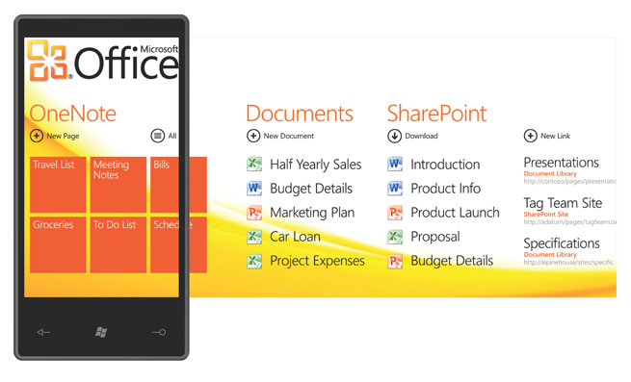

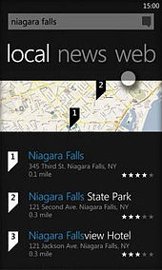
Windows Phone 7 History
Windows Phone 7
Released on October 2010
Metro design
Windows CE-based architecture
Windows Phone 7.5 Mango
Release 2011
Mobile version of IE 9
Multi-tasking of third-party apps
Windows Phone 7.8 (few features of WP 8)

Slide 21
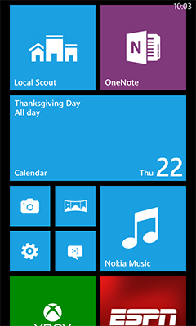
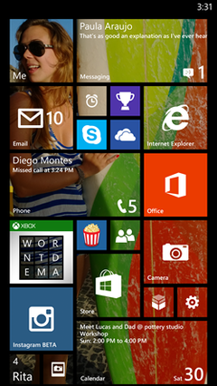
Windows Phone 8 History
Windows Phone 8
Released on October 29, 2012
Flat user interface based on Metro
Windows NT kernel architecture (Win8)
Windows Phone 8.1
Released on April 14, 2014
Cortana, IE 11, HTML 5 videos
Same app model with Windows 8.1
Windows Universal Apps

Slide 22
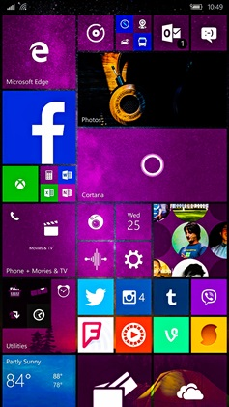
Windows 10 Mobile
Windows 10 Mobile
Released on November 20, 2015
Converged operating system
Greater consistency with PC
New universal application platform
Allows one app to run on multiple Windows 10 devices
Cortana, Edge, Same store as PC
Continuum – Connect it to display and keyboard and you have a PC in your pocket

Slide 23
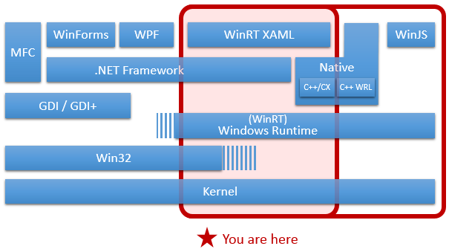
Ways to Develop Windows Applications

Slide 24
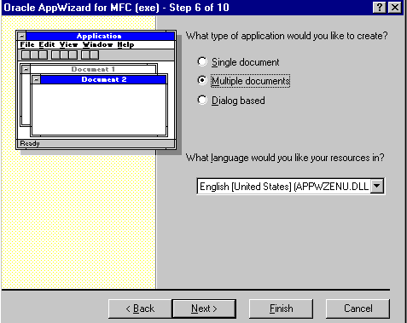
Microsoft Foundation Classes
Introduced 1992
Object-oriented C++ wrapper over much of the Win32 and COM APIs
Classes are defined for many handle-managed Windows objects and
Predefined Windows and common controls
Still under development
https://en.wikipedia.org/wiki/Microsoft_Foundation_Class_Library#Versions

Slide 25
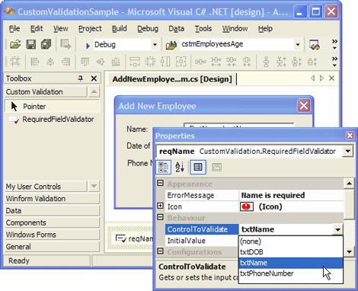
Windows forms
GUI class library
Replaces the Microsoft Foundation Class library
The first C# UI framework
Event driven applications
Access to native Windows User Interface Controls
Better exposure of the Win32 API than MFC
The Control class
Location, size, color, font, text, click, drag

Slide 26
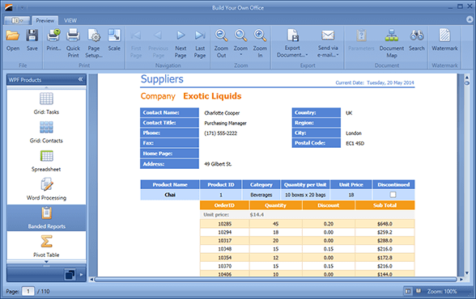
WPF
XAML based
Similar idea to HTML
Uses DirectX and Direct3D
Provides data binding
Rich media support
Vector and raster images, audio and video
Supports animations and templates
Silverlight is a subset of WPF for RIA
As replacement of Flash, later for mobile apps
Deprecated

Slide 27
History of Windows Universal
2010 – Windows Phone 7
Mid-2011 – public beta of Windows 8
Mid-2012 – publicly released Windows 8
Designed for touch
Microsoft’s OS was headed for the tablet
April 2014 – Windows Universal Apps
Convergence of Windows 8.1 and WP 8.1
Create applications that target the phone and tablet and share a single code base
July 2015 – Universal Windows Platform (UWP)
As part of Windows 10 and Windows 10 Mobile

Slide 28
Windows 8.1 Universal Concepts
Develop a universal Windows app that targets Windows and Windows Phone
Share: code, user controls, styles, strings, and other assets between the two projects
Linked files between projects
Conditional compilation with preprocessor directives
#if WINDOWS_APP
// run Windows specific code
#elif WINDOWS_PHONE_APP
// run Windows Phone specific code
#endif

Slide 29
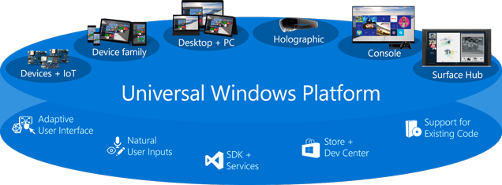
Universal Windows Platform
Released 2015
Targets device families, not an OS
One Store for all devices
Common UI
Responsive controls
Same UI code used for both mobile and desktop

Slide 30


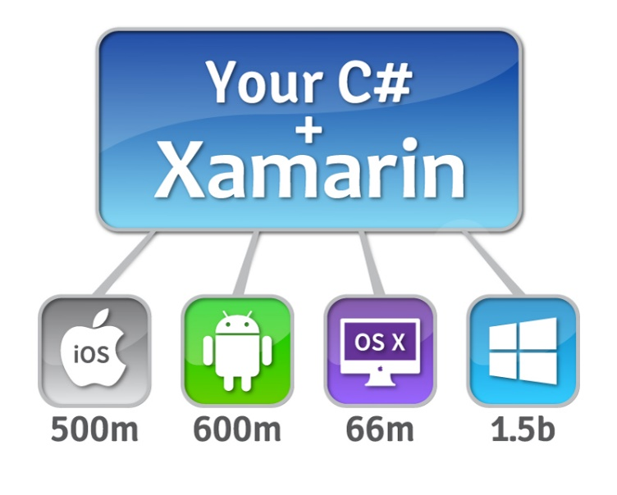
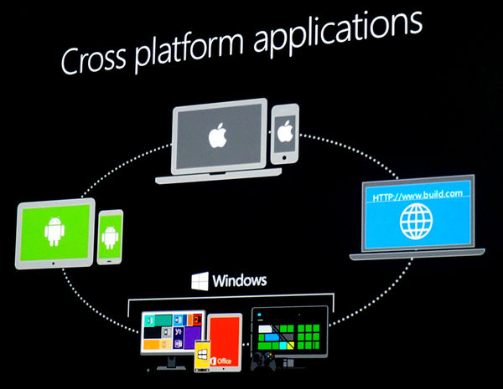
Other Platforms for Creating Windows Apps

Slide 31

Unity3D
A cross-platform game engine
PC, consoles, mobile devices and websites
Can build Windows Universal apps
Supports C# and JavaScript
Can also be used for both 2D and 3D games
There are paid and free versions
telerikacademy.com/Courses/Courses/Details/235

Slide 32
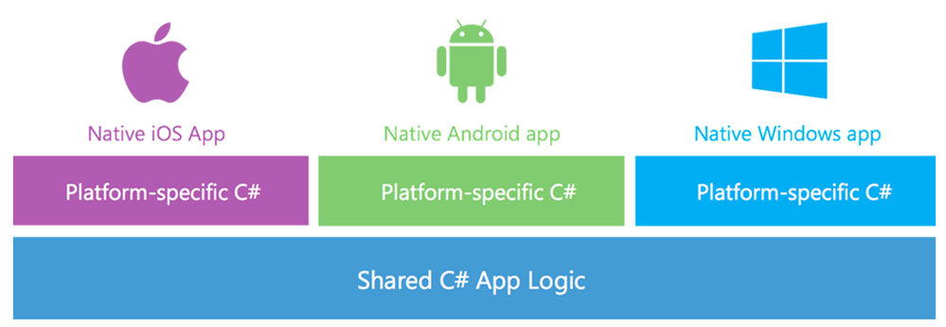
Xamarin and Xamarin Forms
Uses C# code for creating native apps
Xamarin
Shared C# logic
Separate UI for iOS, Android and Windows
By the creators of Mono
Xamarin Forms
Shares both UI and C# logic
Not free
25$/month indie license
999$/year business license
telerikacademy.com/Courses/Courses/Details/227

Slide 33
Apache Cordova
Apache Cordova is an open-source mobile application development framework
Enables building of hybrid mobile applications using JavaScript, HTML and CSS (Ruby as well)
Instead of often less-known languages such as Objective-C and Java
The Cordova applications are hybrid
All layout rendering is done via the web view instead of Objective-C or Java
Most of the HTML5 features are supported
Yet, as any hybrid app, Cordova apps do not have full access to the device API (Camera, accelerometer, etc.)
telerikacademy.com/Courses/Courses/Details/190

Slide 34
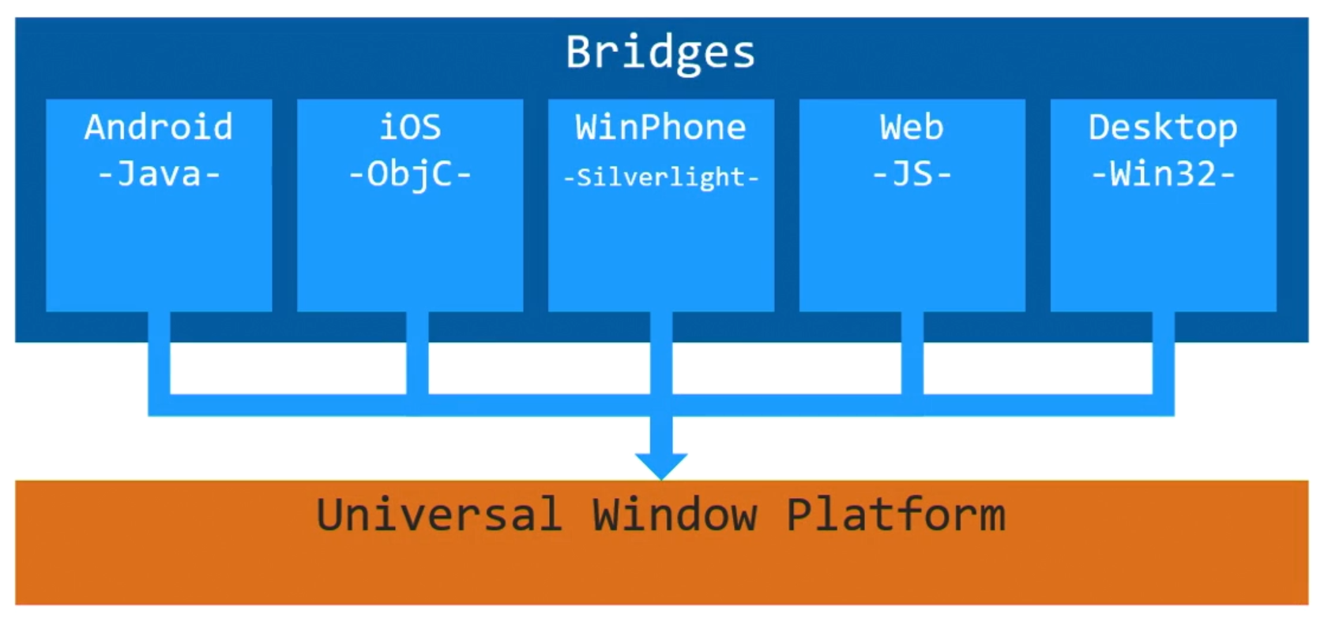
Windows Bridges
Take existing code or project and convert it to a Universal Windows Application
Use a Microsoft interoperability library to integrate Microsoft services into your app
Test and debug from your preferred IDE
Publish through the Windows Store

Slide 35
Windows-based Applications
http://academy.telerik.com

